Slide 1
Communication & Presentation skills LAB 5G Wireless Technology

Slide 2
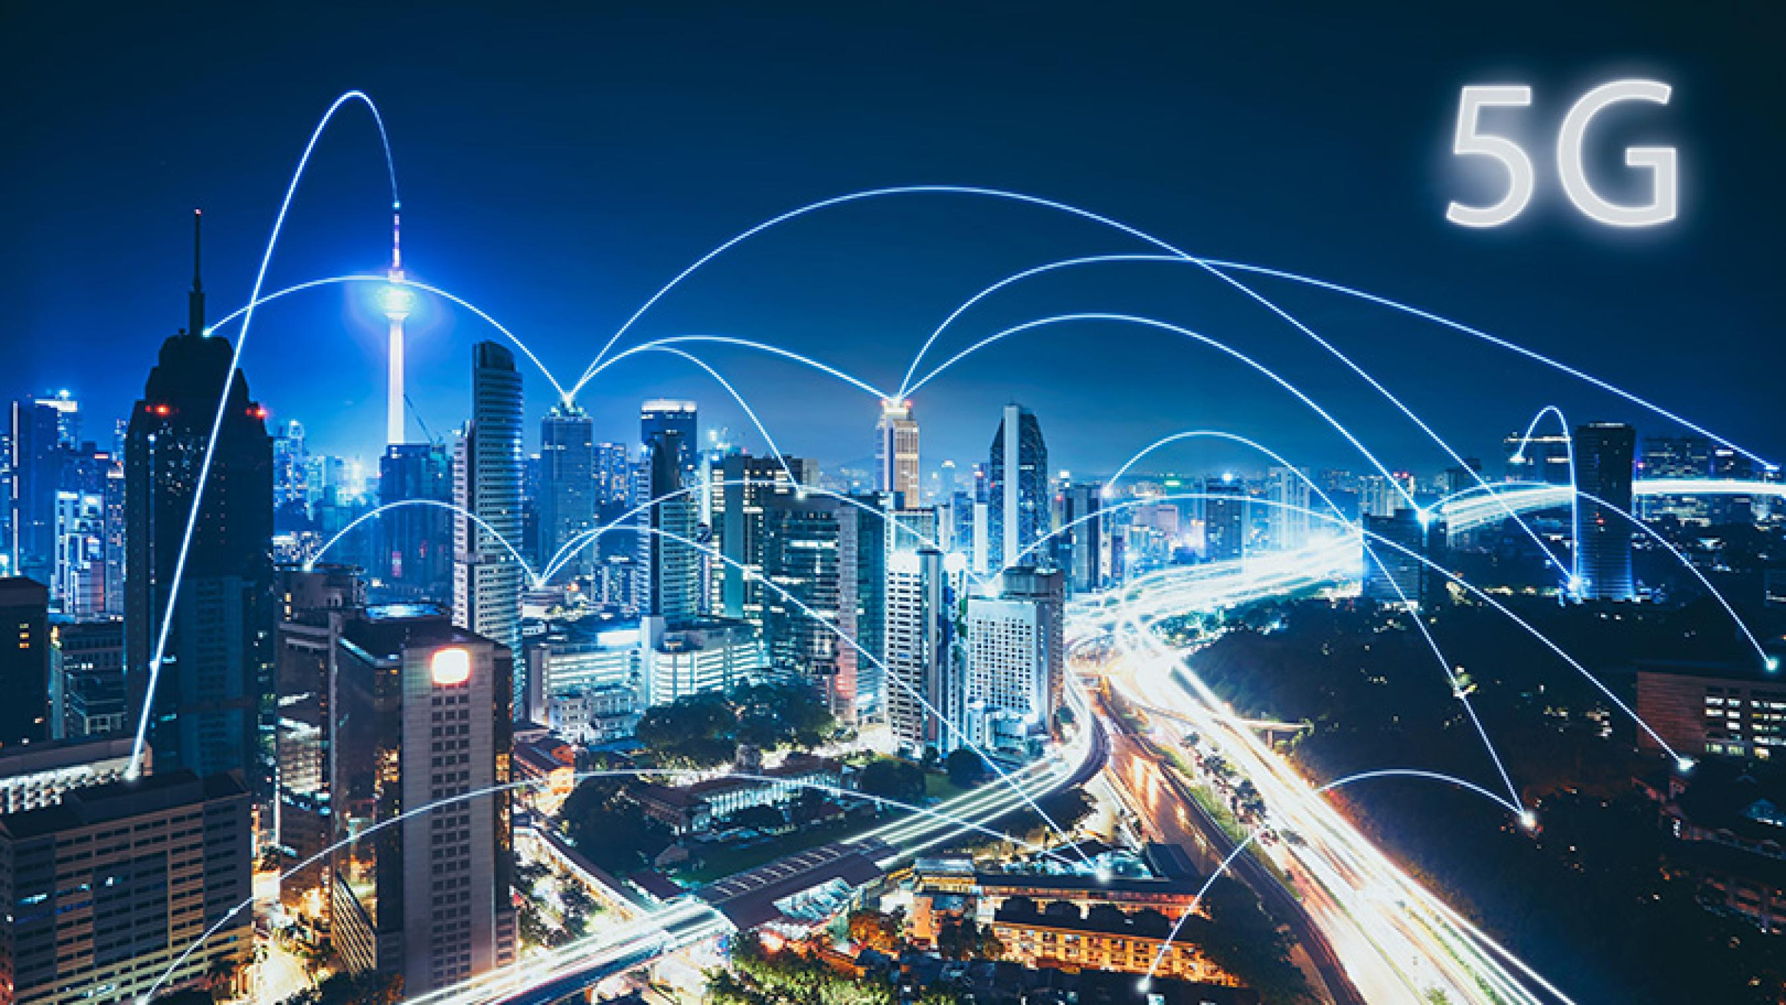
What is 5G?
History
Definition

Slide 3
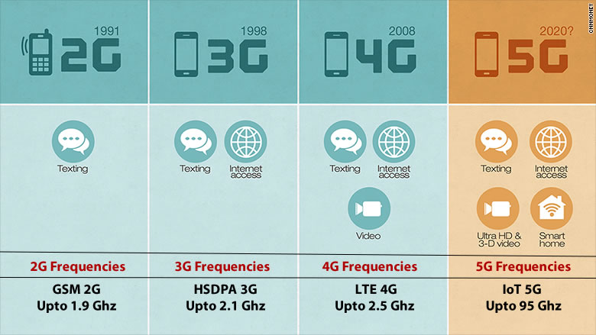
How 5G works?
Frequency
Bandwidth

Slide 4
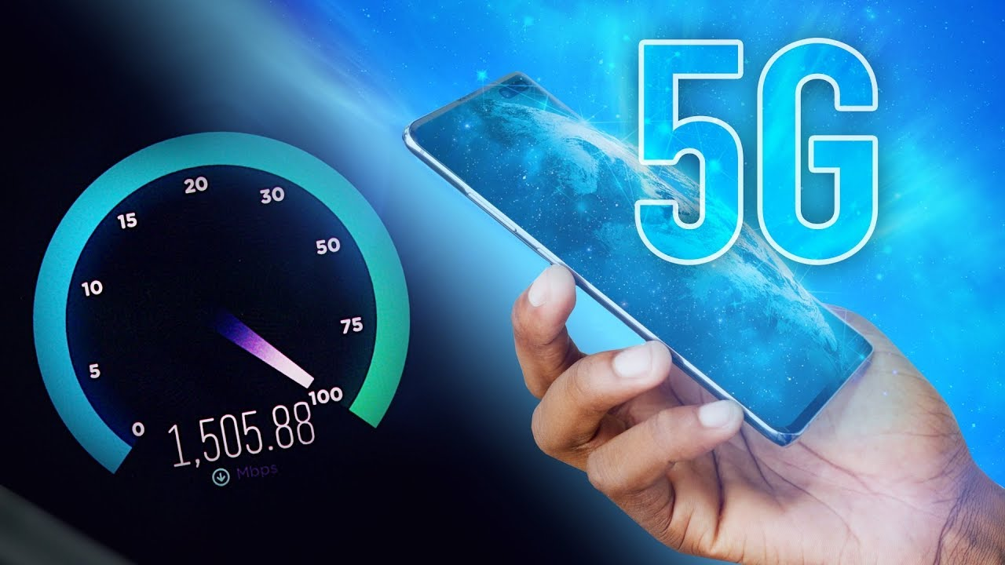
Performance Difference
Speed

Slide 5

Not only about Speed!
Low Latency

Slide 6
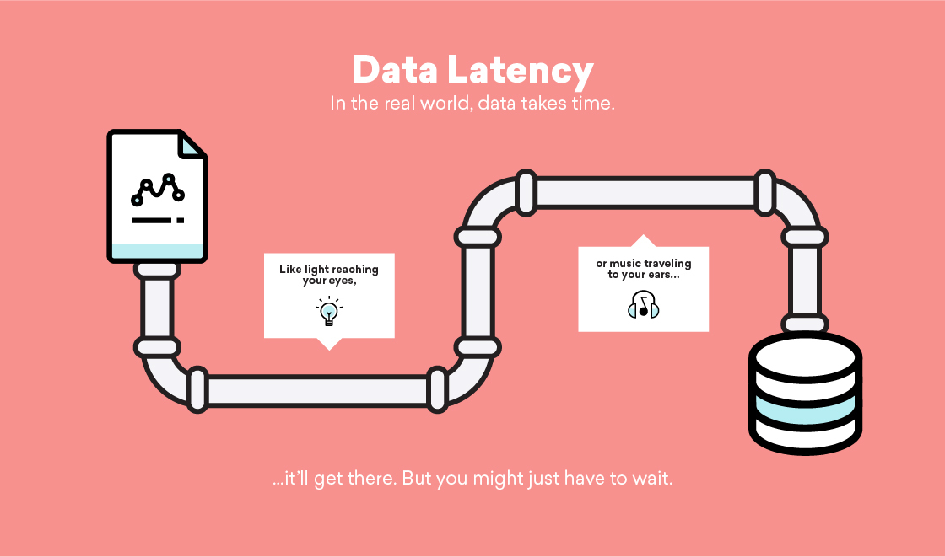
What is Latency?

Slide 7
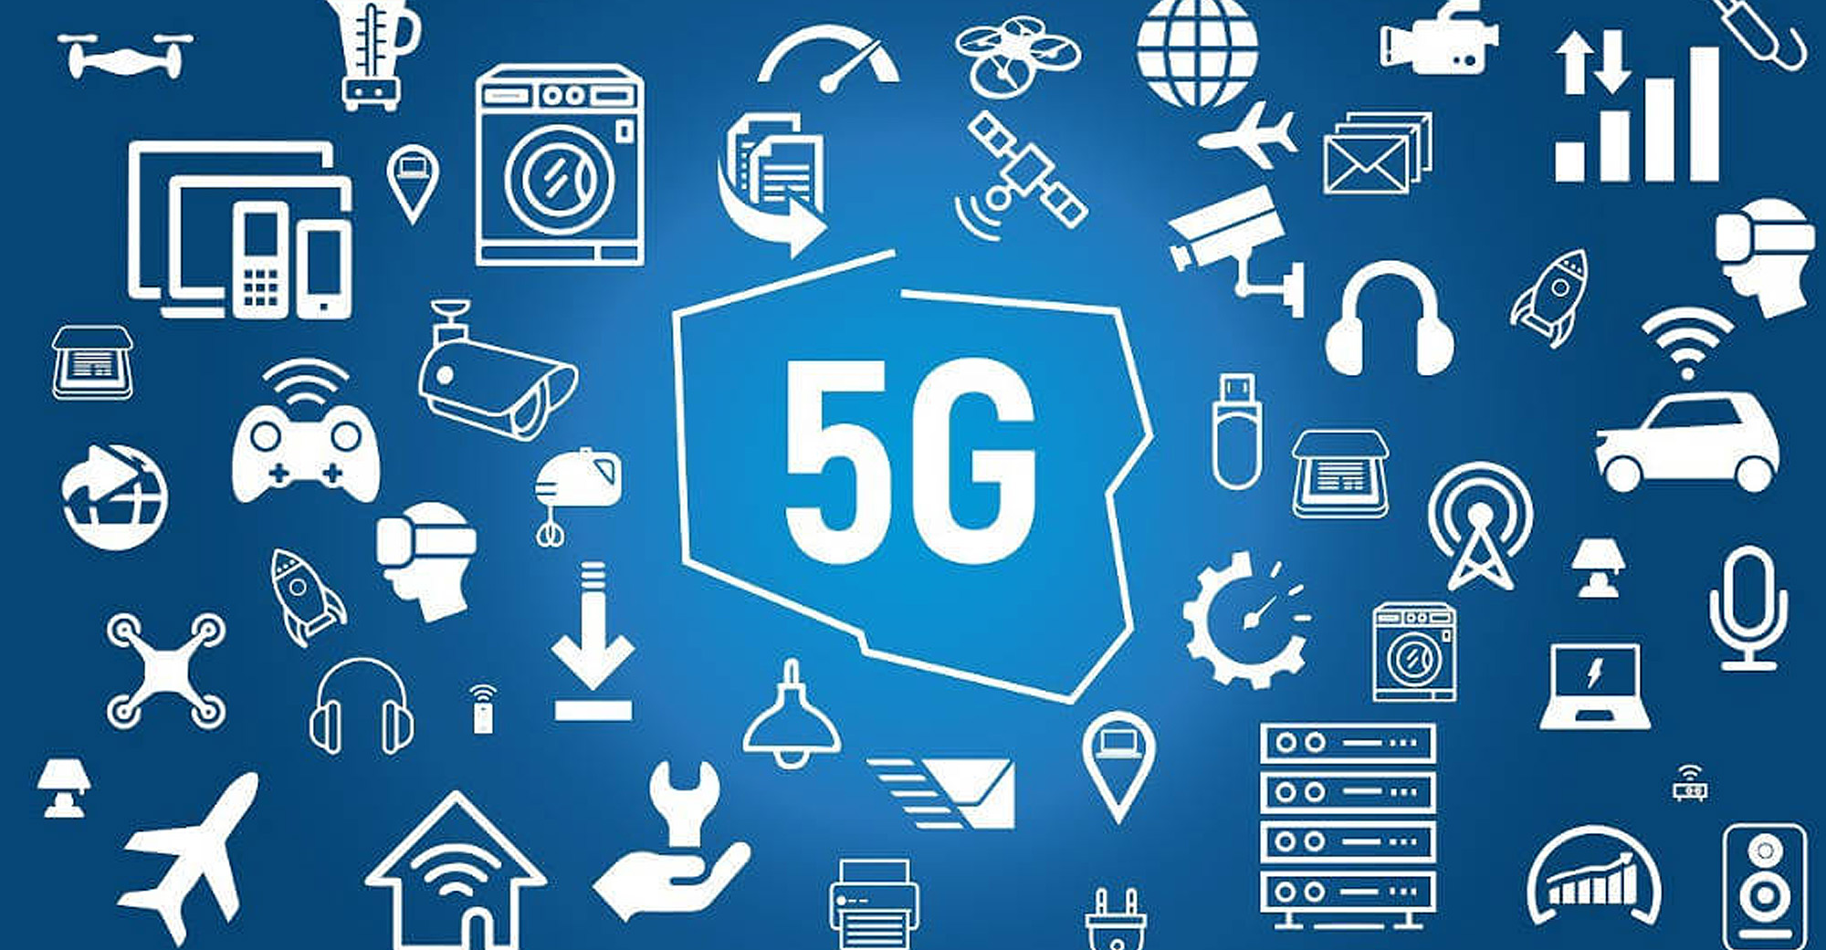
What can 5G do?
Autonomous Cars
Competitive Gaming
Cloud Computing
Real-Time Streaming
Better handling of dense packets of users

Slide 8


